Slide 1
Express Yourself
Basic 5 – Unit 2b
Body Language and Gestures

Slide 2

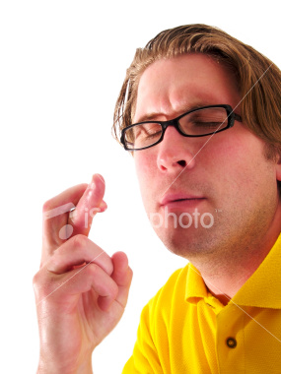
What is he doing?
He is
shrugging
He is his fingers
crossing

Slide 3
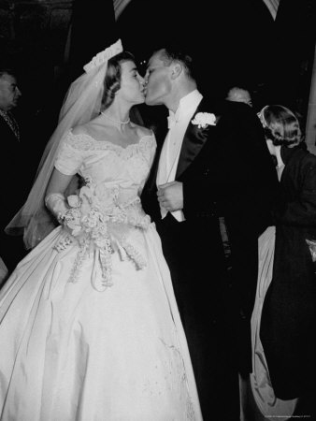
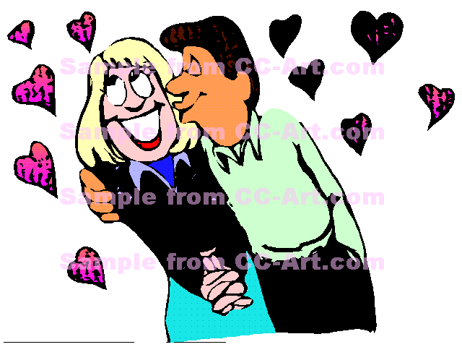
What are they doing?
What is he doing?
They are kissing.
He is kissing the woman

Slide 4
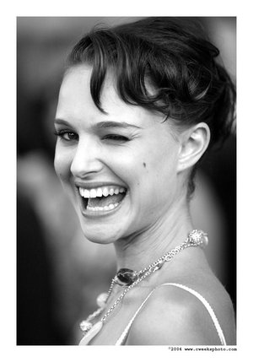
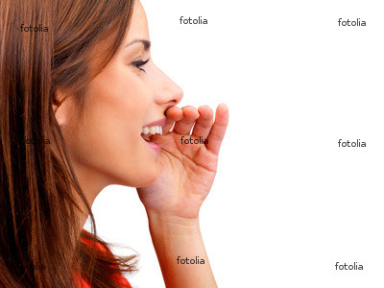
What is she doing?
What is she doing?
She is calling someone
She is winking (at me)

Slide 5
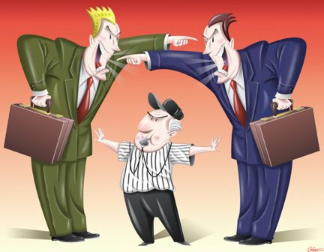
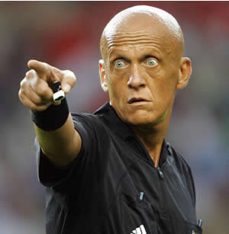
What are they doing?
What is he doing?
They are pointing at each other
He is pointing (at a person)

Slide 6
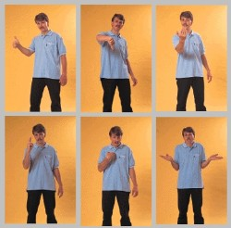
What do these gestures mean?

Slide 7
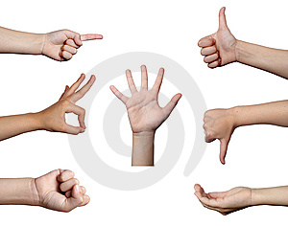
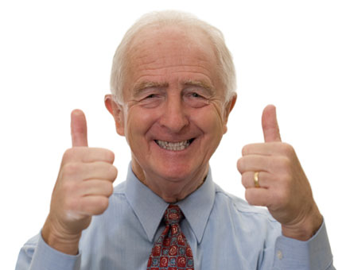
What do these gestures mean?

